Slide 1

Neuromend
By Tempest
An ICT313 Games Technology Project
  Ary Bizar, Anopan Kandiah, Hannah Klinac, Alex Mlodawski, Bryan Yu

Slide 2
Introduction
Client: Shri Rai
Supervisor: Fairuz Shiratuddin
Team Name: Tempest
Team Members:
  Ary Bizar
  Anopan Kandiah
  Hannah Klinac
  Alex Mlodawski
  Bryan Yu
Project Name: Neuromend

Slide 3
Project Management
Methodology
  SCRUM
    Several changes to the requirements occurred during the project’s lifecycle and adopting this methodology has helped meet deadlines in that respect.
Weekly team/supervisor meetings
  Discussed requirements
  Discussed issues
  Demonstrated prototypes
Source code control
  GitHub
    Separate folders for each device
    Folder for documentation

Slide 4
Background
Stroke
  How it affects the brain
Rehabilitation
  Rewiring

Slide 5
Problem
Rehabilitation
  Expensive
  Tedious/boring
  Limited

Slide 6
Solution
Virtual Simulation
  3 worlds
Devices
  Oculus + Keyboard and mouse
  Oculus + Razer Hydra
  Oculus + Kinect
  Oculus + Leap Motion
Sensitivity/Settings
Monitoring progress
Profiles on a database

Slide 7

World (Ary)

Slide 8
Database

Slide 9
Razer Hydra (Bryan)

Slide 10
Kinect (Alex + Anopan)

Slide 11
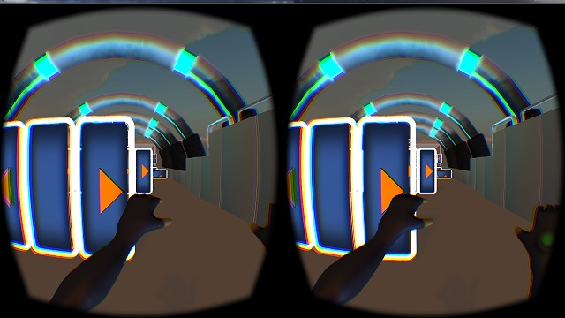
Kinect Object Avoidance
Moves player forward automatically at an adjustable speed.
4 gestures-
  Strafe left
    Use of left hand only
  Strafe right
    Use of right hand only
  Jump
    Use of both hands
  Crouch
    Use of both hands
Degree of hand/arm movement is dependent on the sensitivity setting.

Slide 12
Leap Motion (Hannah)

Slide 13
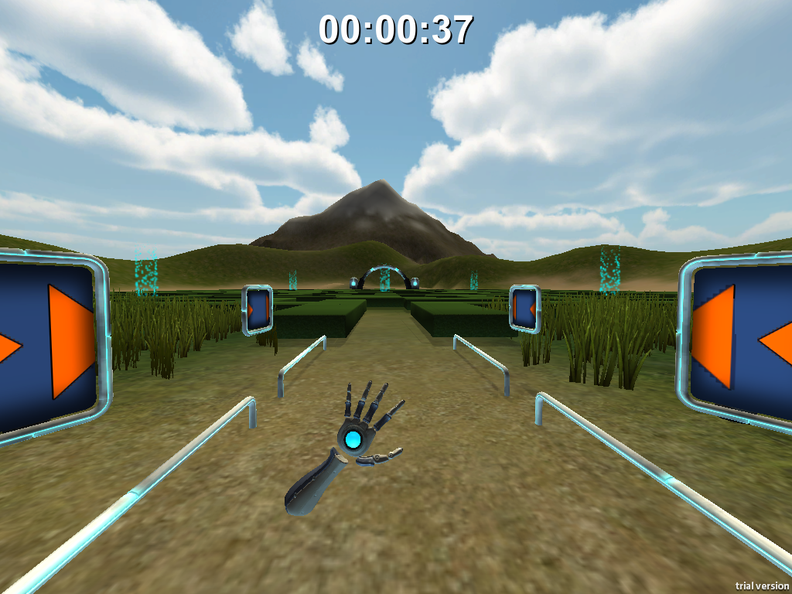
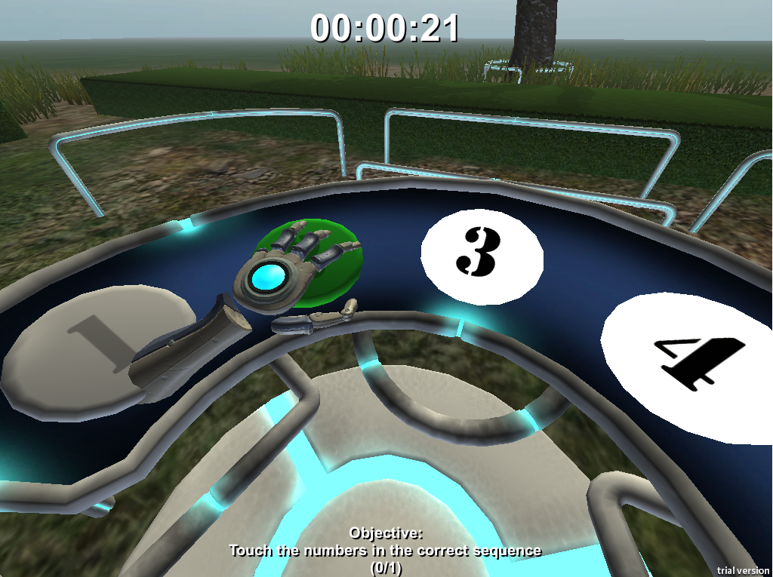
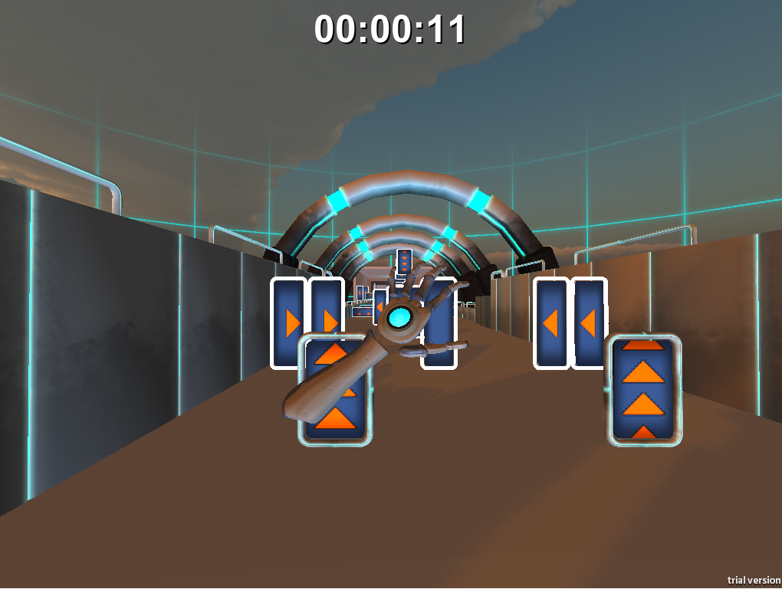
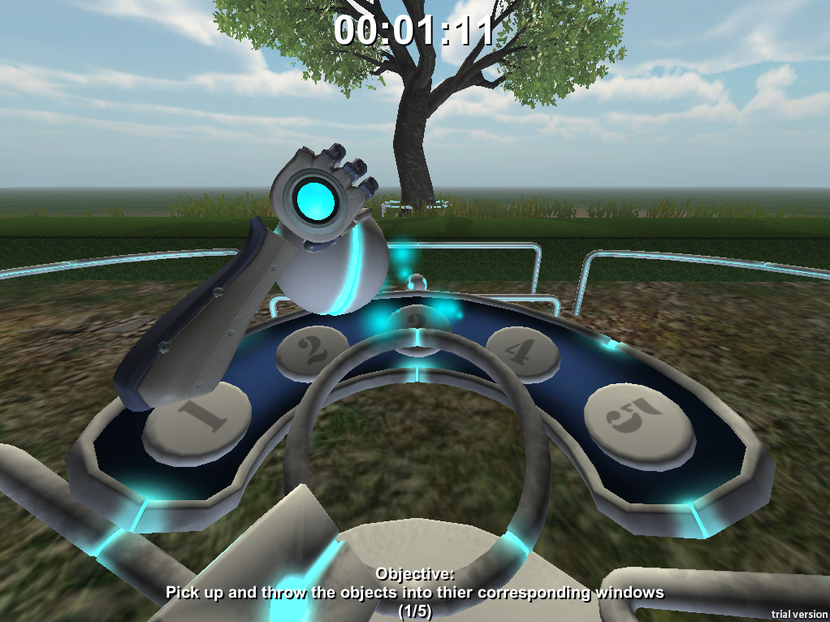
Leap Motion

Slide 14
Current Status
Virtual Simulation
3 levels
Devices
Database
Sensitivity/settings

Slide 15
Future Possibilities
Clinical use
Adding speech

Slide 16
Challenges and Lessons Learned
Devices
  Beta products
  Driver clashes
  Versions/compatability
Designing movements/gestures
Version control (levels + devices)
Communication

Slide 17
Acknowledgements
Client – Mr Shri Rai
Supervisor – Dr Fairuz Shiratuddin

Slide 18
Questions?

